Slide 1
Motivation

Slide 3
Why vision is so hard?

Slide 4
Why is vision so hard?
Ill-posed problem
Recovering 3D geometry from a single 2D image is mathematically impossible.
A single 2D projection can be produced by any of infinite number of 3D geometrical configurations.
[Sinha and Adelson 1993]
Notes:
Recovering 3D geometry from a single 2D image is mathematically impossible. A single 2D projection can be produced by any of infinite number of 3D geometrical configurations.

Slide 5
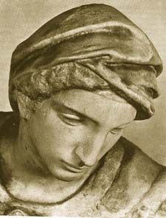
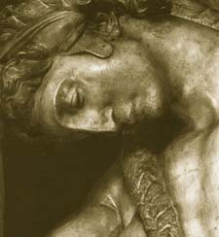
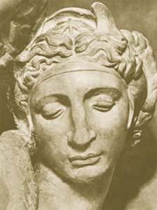
Challenges 1: view point variation
Michelangelo 1475-1564
slide by Fei Fei, Fergus & Torralba

Slide 6


Challenges 2: illumination
slide credit: S. Ullman

Slide 7
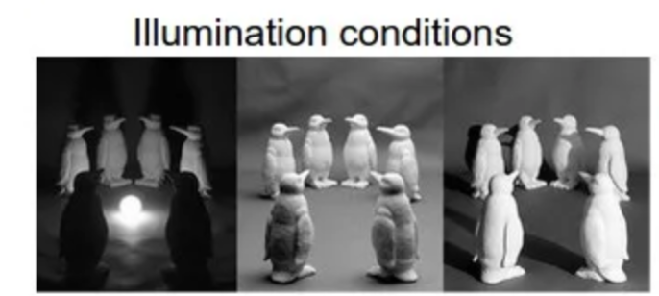

Slide 8

Challenges 3:
occlusion
Magritte, 1957
slide by Fei Fei, Fergus & Torralba

Slide 9
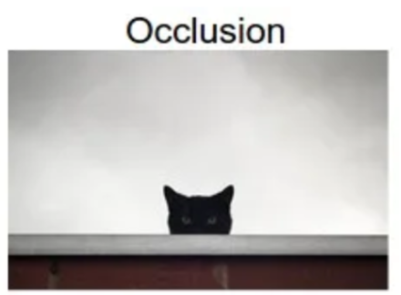

Slide 10
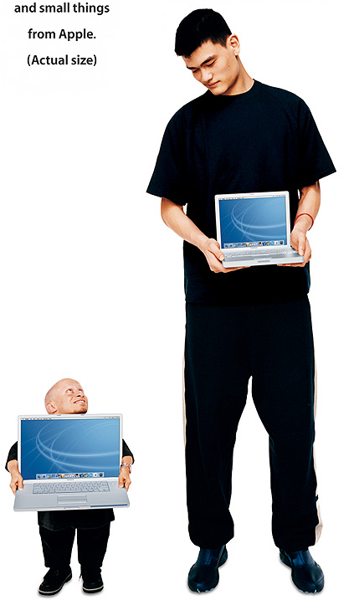
Challenges 4: scale
slide by Fei Fei, Fergus & Torralba

Slide 11
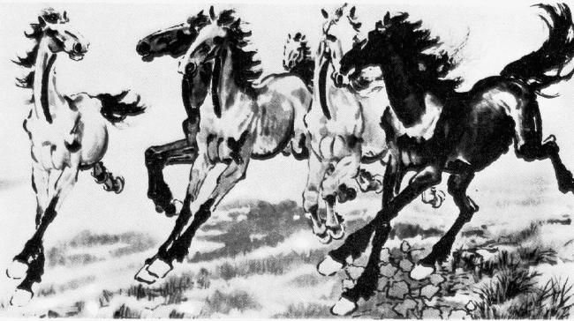
Challenges 5: deformation
slide by Fei Fei, Fergus & Torralba
Xu, Beihong 1943

Slide 12
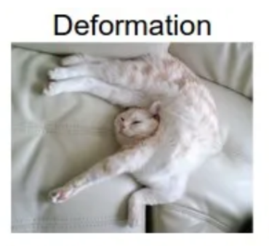

Slide 13
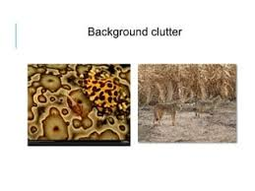
Challenges 6: background clutter
slide by Fei Fei, Fergus & Torralba

Slide 14
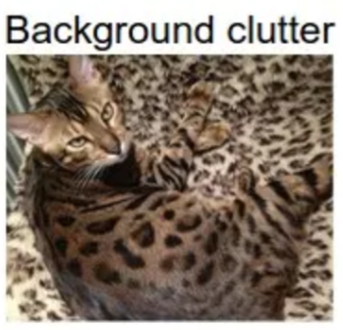

Slide 15

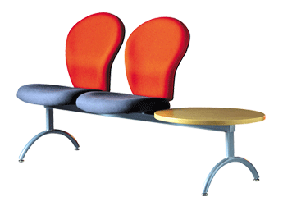
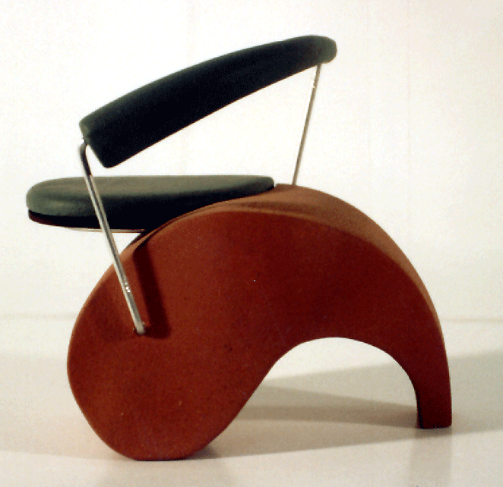
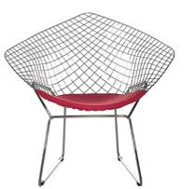
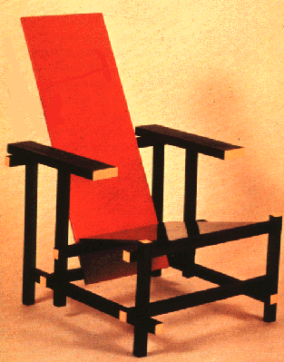
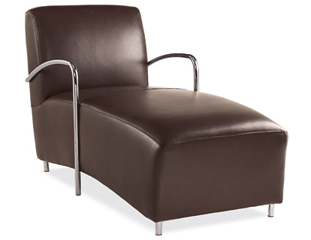
Challenges 7: object intra-class variation
slide by Fei-Fei, Fergus & Torralba

Slide 16


Challenges 8: local ambiguity
slide by Fei-Fei, Fergus & Torralba
Notes:
What is that patch in the different images? hand, shoes person talking on cellphone, car, person

Slide 17
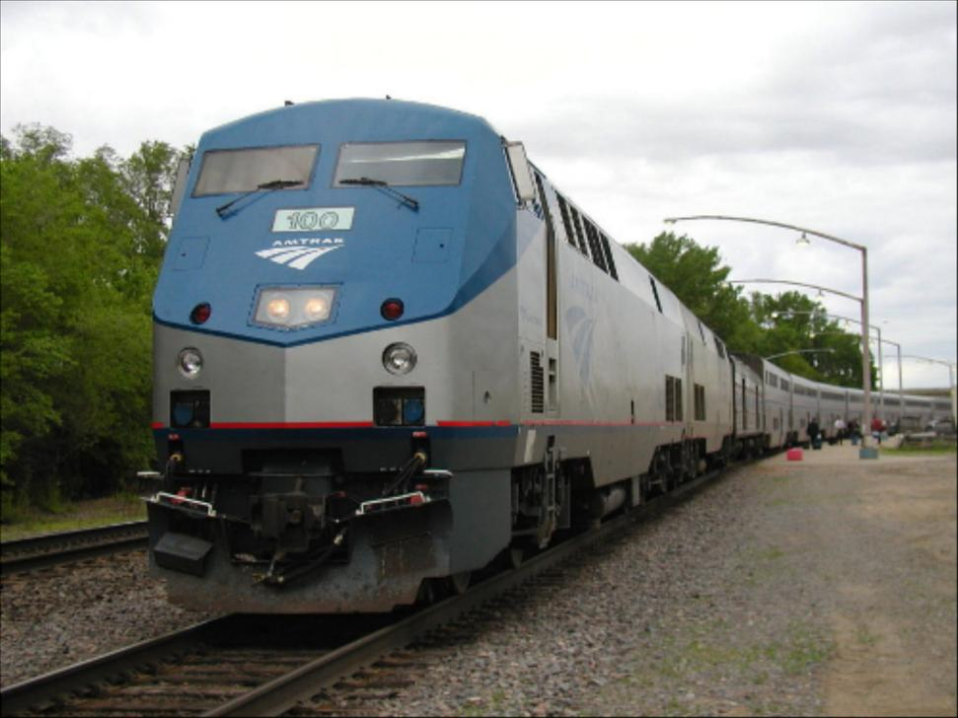

Challenges 9: the world behind the image
Slide Credit: Alyosha Efros

Slide 18
The Challenges
Viewpoint variation. A single instance of an object can be oriented in many ways with respect to the camera.
Scale variation. Visual classes often exhibit variation in their size (size in the real world, not only in terms of their extent in the image).
Deformation. Many objects of interest are not rigid bodies and can be deformed in extreme ways.
Occlusion. The objects of interest can be occluded. Sometimes only a small portion of an object (as little as few pixels) could be visible.
Illumination conditions. The effects of illumination are drastic on the pixel level.
Background clutter. The objects of interest may blend into their environment, making them hard to identify.
Intra-class variation. The classes of interest can often be relatively broad, such as chair. There are many different types of these objects, each with their own appearance.

Slide 19
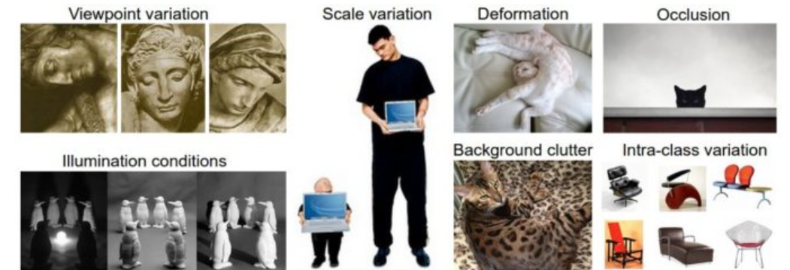

Slide 20
Current state of the art
The next slides show some examples of what current vision systems can do.

Slide 21
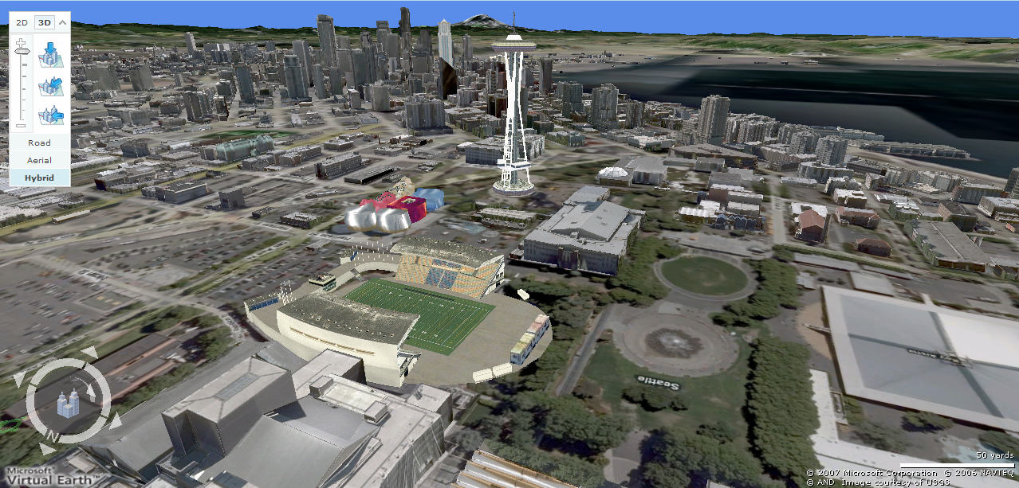
Earth viewers (3D modeling)
Image from Microsoft’s Virtual Earth
(see also: Google Earth)

Slide 22
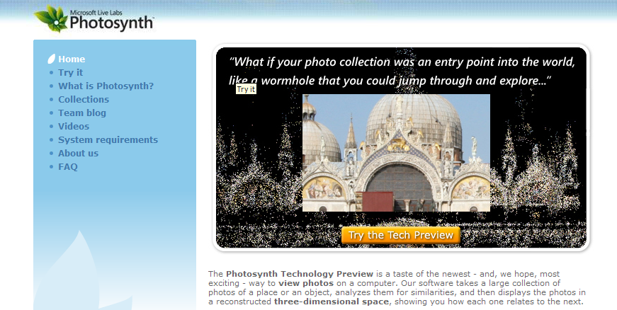
Photosynth
http://labs.live.com/photosynth/
Based on Photo Tourism technology developed here in CSE! by Noah Snavely, Steve Seitz, and Rick Szeliski

Slide 23
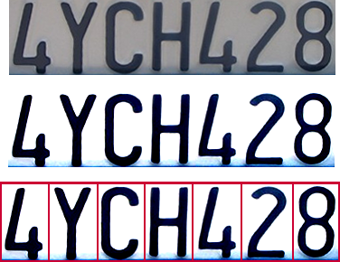

Optical character recognition (OCR)
Technology to convert scanned docs to text
If you have a scanner, it probably came with OCR software
Digit recognition, AT&T labs
http://www.research.att.com/~yann/
License plate readers
http://en.wikipedia.org/wiki/Automatic_number_plate_recognition

Slide 24
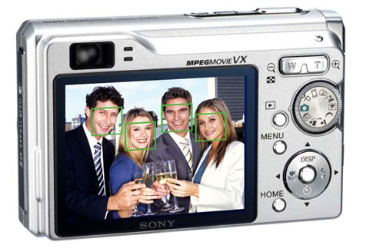
Face detection
Many new digital cameras now detect faces
Canon, Sony, Fuji, …
Notes:
Why would this be useful? Main reason is focus. Also enables “smart” cropping.

Slide 25
Smile detection?
Sony Cyber-shot® T70 Digital Still Camera

Slide 26
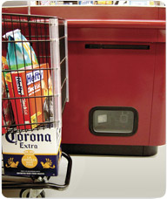
Object recognition (in supermarkets)
LaneHawk by EvolutionRobotics
“A smart camera is flush-mounted in the checkout lane, continuously watching for items. When an item is detected and recognized, the cashier verifies the quantity of items that were found under the basket, and continues to close the transaction. The item can remain under the basket, and with LaneHawk,you are assured to get paid for it… “

Slide 27

Face recognition
Who is she?

Slide 28
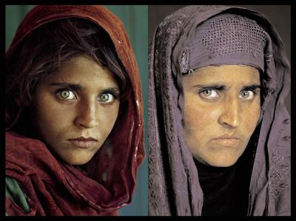
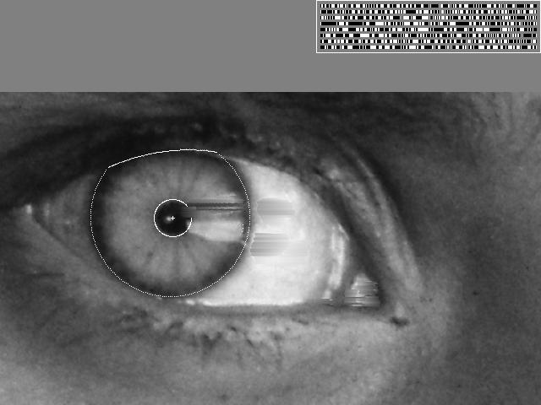
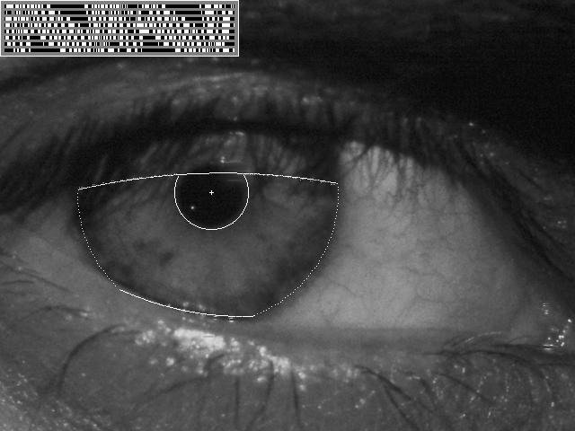
Vision-based biometrics
“How the Afghan Girl was Identified by Her Iris Patterns” Read the story

Slide 29
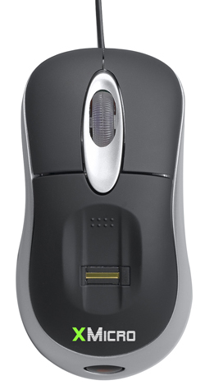



Login without a password…
Fingerprint scanners on many new laptops, other devices
Face recognition systems now beginning to appear more widely http://www.sensiblevision.com/

Slide 30
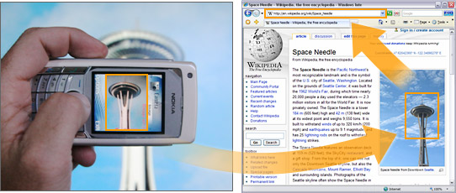

Object recognition (in mobile phones)
This is becoming real:
Microsoft Research
Point & Find, Nokia

Slide 31
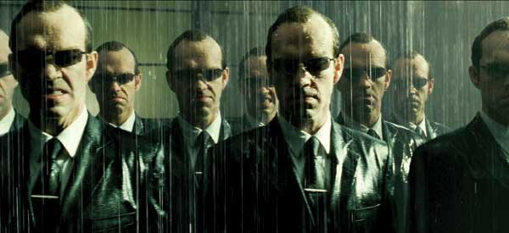
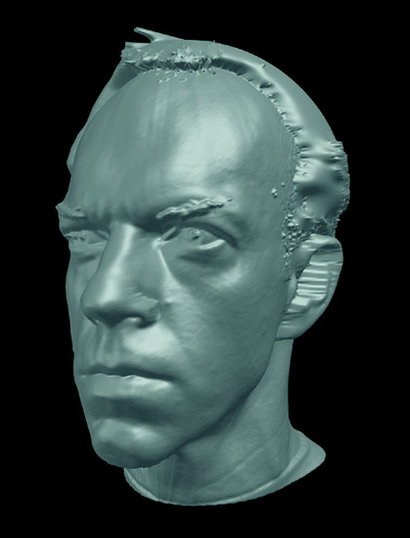
Special effects: shape capture
The Matrix movies, ESC Entertainment, XYZRGB, NRC

Slide 32
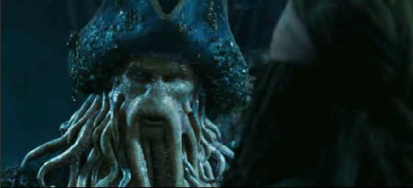
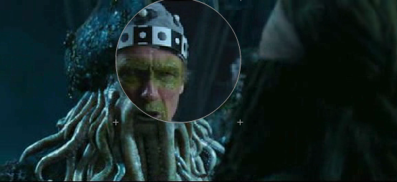
Special effects: motion capture
Pirates of the Carribean, Industrial Light and Magic
Click here for interactive demo

Slide 33
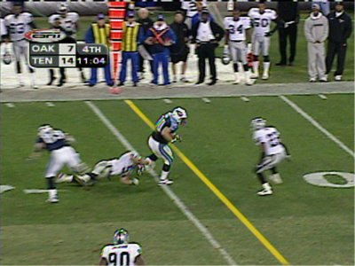
Sports
Sportvision first down line
Nice explanation on www.howstuffworks.com

Slide 34
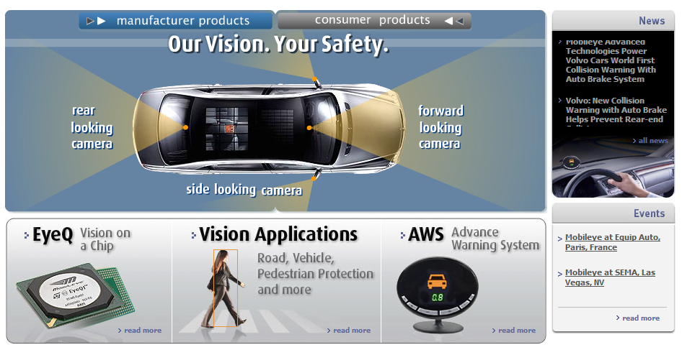
Smart cars
Slide content courtesy of Amnon Shashua
Mobileye
Vision systems currently in high-end BMW, GM, Volvo models
By 2010: 70% of car manufacturers.
Video demo

Slide 35
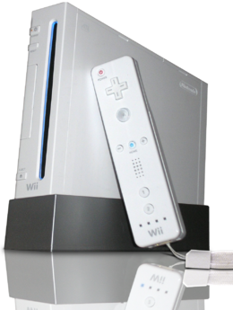
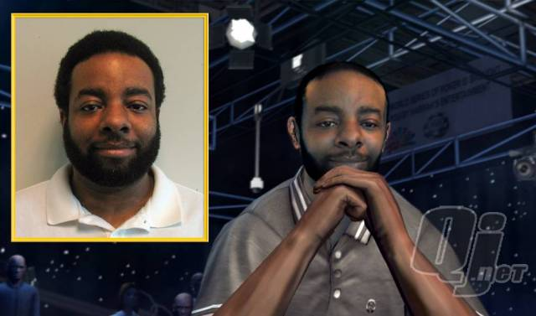
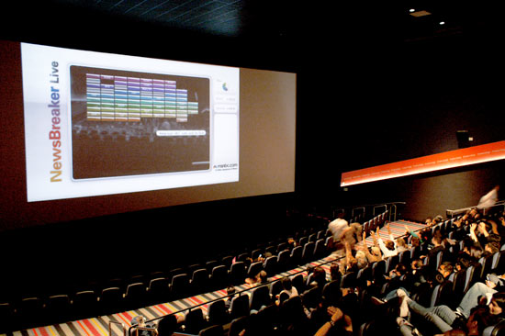
Vision-based interaction (and games)
Digimask: put your face on a 3D avatar.
Nintendo Wii has camera-based IR tracking built in. See Lee’s work at CMU on clever tricks on using it to create a multi-touch display!
“Game turns moviegoers into Human Joysticks”, CNET
Camera tracking a crowd, based on this work.

Slide 36
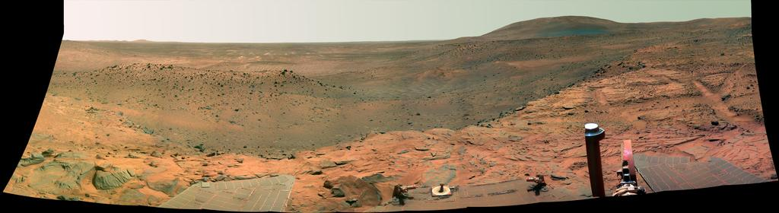
Vision in space
NASA'S Mars Exploration Rover Spirit captured this westward view from atop a low plateau where Spirit spent the closing months of 2007.
Vision systems (JPL) used for several tasks
Panorama stitching
3D terrain modeling
Obstacle detection, position tracking
For more, read “Computer Vision on Mars” by Matthies et al.

Slide 37

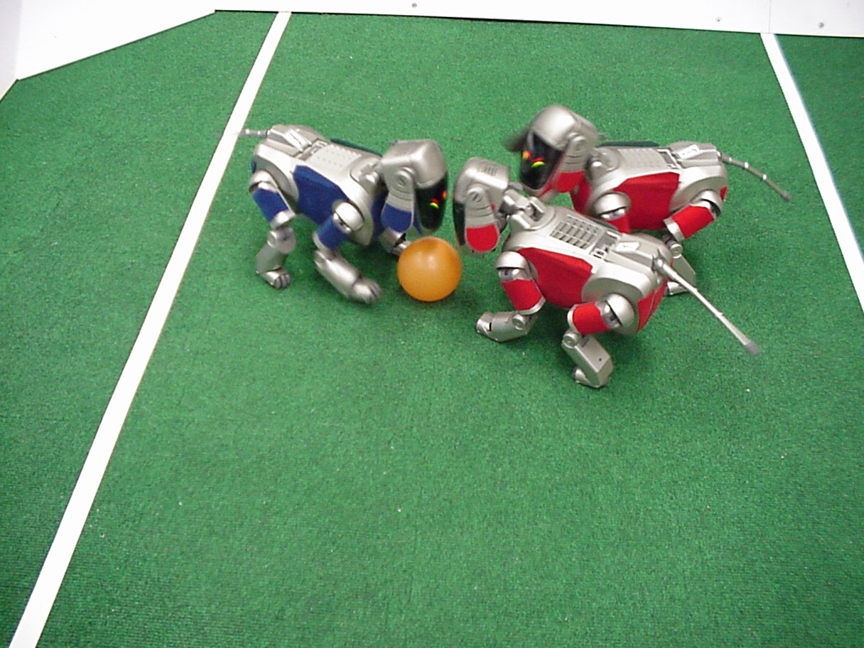
Robotics
NASA’s Mars Spirit Rover
http://en.wikipedia.org/wiki/Spirit_rover
http://www.robocup.org/

Slide 38
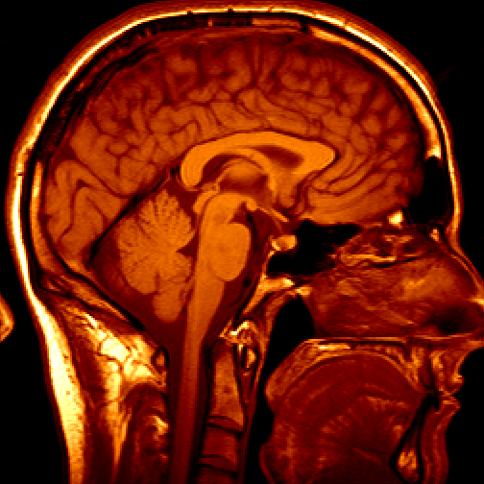
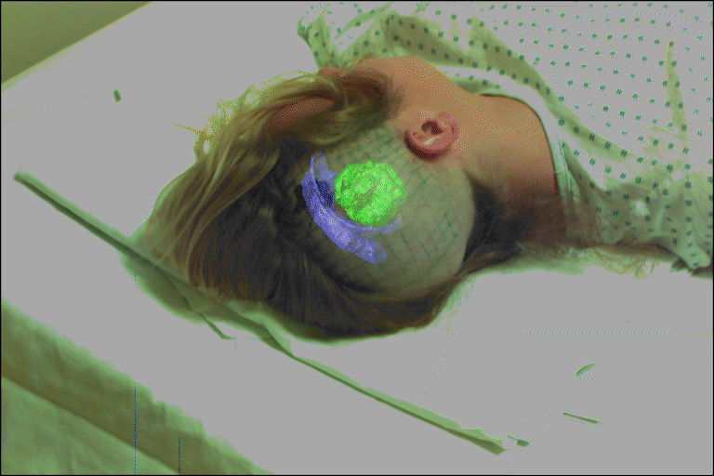
Medical imaging
3D imaging
MRI, CT
Image guided surgery
Grimson et al., MIT

Slide 39
Current state of the art
You just saw examples of current systems.
Many of these are less than 5 years old
This is a very active research area, and rapidly changing
Many new apps in the next 5 years
To learn more about vision applications and companies
David Lowe maintains an excellent overview of vision companies
http://www.cs.ubc.ca/spider/lowe/vision.html

Slide 40
What is it related to?
Biology
Information Engineering
Neuroscience
Computer Science
Robotics
Computer Vision
Speech
Information retrieval
Machine learning
Physics
Maths

Slide 41
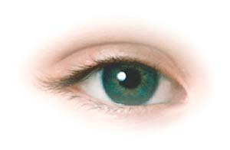


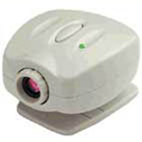
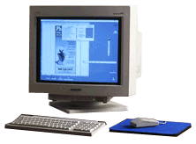
The problem
Want to make a computer understand images
We know it is possible – we do it effortlessly!
Real world scene
Sensing device
Interpreting device
Interpretation
A person/ A person with folded arms/ Prof. Pietro Perona/ etc.
Notes:
Sounds easy: we do it effortlessly
Eyes “take the picture” then brain interprets it for us
Want computer to be able interpret digital images

Slide 42
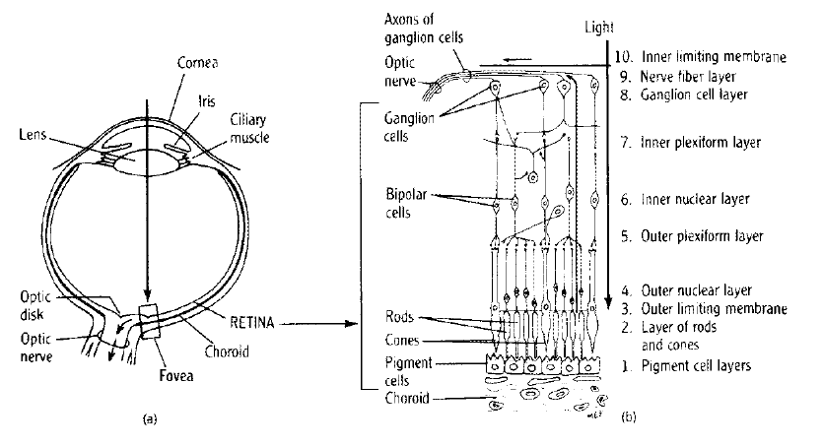
The Human Eye
Retina measures about 5 × 5 cm and contains 10⁸ sampling elements (rods and cones).
The eye’s spatial resolution is about 0.01◦ over a 150◦ field of view (not evenly spaced, there is a fovea and a peripheral region).
Intensity resolution is about 11 bits/element, spectral range is 400–700nm.
Temporal resolution is about 100 ms (10 Hz).
Two eyes give a data rate of about 3 GBytes/s!

Slide 43
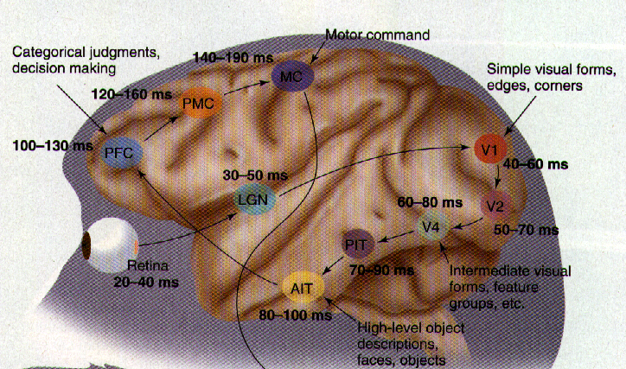
Human visual system
Vision is the most powerful of our own senses.
[Thorpe et. al.]
Around 1/3 of our brain is devoted to processing the signals from our eyes.
The visual cortex has around O(10¹¹) neurons.

Slide 44


Why don’t we just copy the human visual system?
People try to but we don’t yet have a sufficient understanding of how our visual system works.
O(10¹¹) neurons used in vision
By contrast, latest CPUs have O(10⁸) transistors (most are cache memory)
Very different architectures:
Brain is slow but parallel
Computer is fast but mainly serial
Bird vs Airplane
- Same underlying principles
- Very different hardware
Notes:
Researchers do try and simulate what we know about our visual system
- e.g. simple and complex cell responses in V1

Slide 45
Vision as data reduction
Raw feed from camera/eyes:
10⁷⁻⁹ Bytes/s
Extraction of edges and salient features
10³⁻⁴ Bytes/s
High-level interpretation of scene
10¹⁻² Bytes/s

Slide 46
Definitions

Slide 47
A Brief History

